Slide 1

Big Game Census Analytics

Slide 2
Introduction
My name is Deepak Gupta and I am work in Unified Mentor Pvt. Ltd. as a Data Scientist intern. I am select this project during the internship because I feel this is a very interesting project for learn something new skills for my future. This project is related to Sports domain.
The Big Game Census is an interactive visualization that uses data from the U.S. Census Bureau to explore the hometowns and birthplaces of Super Bowl players. The visualization also includes related population data and other fun facts about the players, such as which colleges they attended. Instead of using the term Super Bowl during the event, commercials call it the “Big Game”. It’s simply because it is a registered NFL.

Slide 3
Project Details
Project Title | Big Game Census Analytics
Technologies | Data Science
Domain | Sports
Project Difficulties Level | Advanced
Tools | Python(Jupiter Notebook), Microsoft PowerBI, Microsoft Power Point, and Microsoft Excel

Slide 4
Objective of the Project
Aims relate to the overall intent, strategic direction and purpose of your event i.e. the primary motivations, Objectives are essentially aims broken down into specific targets, to facilitate event delivery and evolutions.
It helps organizations harness the power of data, enabling them to make decisions, optimize process, and gain a competitive edge. By turning raw data into meaningful insights, data analysis empowers business to identity opportunities, mitigate risks, and enhance their overall performance
Statistics can be used for the analysing data and drawing conclusions from it. It can also be used for making predictions about future events and behaviours. Statistics also help us understand how things are changing over time.

Slide 5
Problem Statement
This Big Game Census data visualization takes a fun look at where Super Bowl 52 players come from, the related population figures, and opens up pathways (via embedded links) to additional census data points.
The dataset came about when two hapless data nerds had their teams eliminated from the playoffs, thus turning to data to try to find more rooting interests for Super Bowl 52.
The rosters for both, competing teams are included, with the corresponding roster information and birthplace and state population information. The developers utilized census data pulled from census.gov, and roster information from Yahoo Sports, and designed the data visualization within the Tableau platform.
Identify fun facts you've found within this data and/or data visualization, and has that swayed your rooting interest in the game?

Slide 6
Dataset Information
This is a sports related dataset that contains information like:- Player Name, Player Jersey Name, Player Position, Player Age, Player Weight (lbs.), Years Played, etc.
Population Census provides basic statistics on state of human resources, demography, culture and economic structure at local, regional and national level. All this information is vital to guide and shape the future course of the nation.

Slide 7
Overview of the Project
Player’s Collage | South Carolina
Average Age | 26.72
Average Weight | 243.88
Player’s Weight | 218
Player’s Age | 27

Slide 8
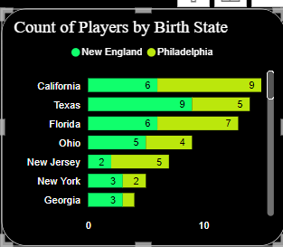
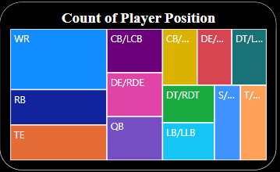
Analysis of Players by Birth State and Position

Slide 9
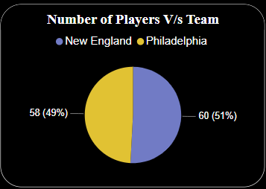
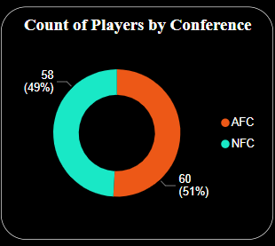
Analysis of Players

Slide 10
Thank You
Detailed Project Report Submitted by
Deepak Gupta

